Slide 1
IMPLEMENTATION OF CONVOLUTIONAL NEURAL NETWORKS IN FPGA FOR IMAGE CLASSIFICATION
Mark A. Espinosa
Spring 2019

Slide 2
Background Info
What is Deep Learning?

Slide 3
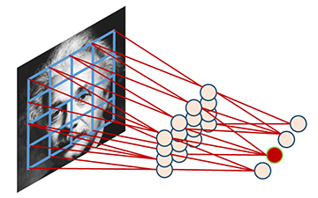
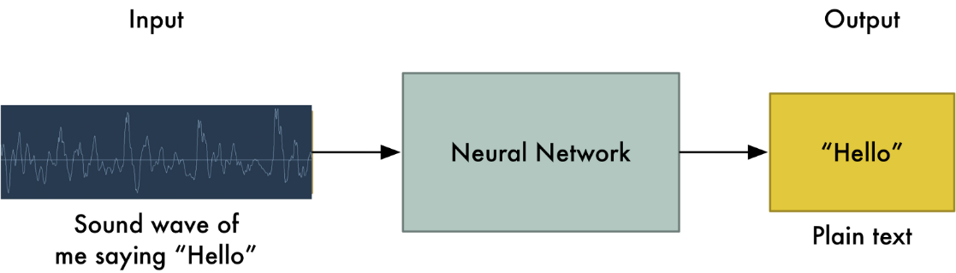
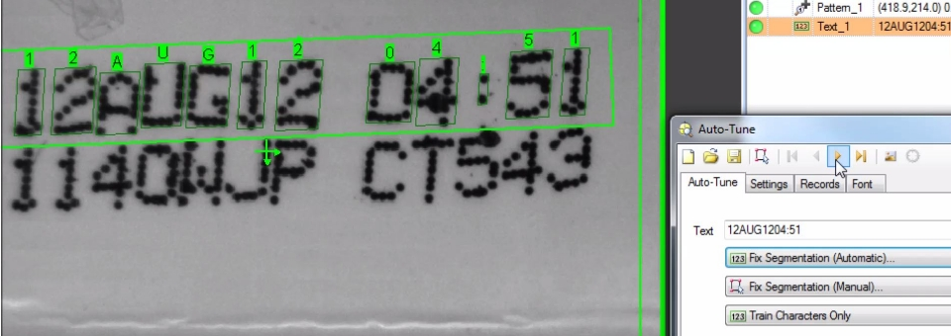
Machine Learning
Machine learning can be described as when a computer program is said to learn from experience E with respect to some task T and some performance measure P, if its performance on T, as measured by P, improves with experience E.
Learning algorithms have been successfully deployed in a variety of applications, including:
Speech recognition, speech synthesis, speaker verification
Optical character recognition (OCR)
Computer vision tasks

Slide 4
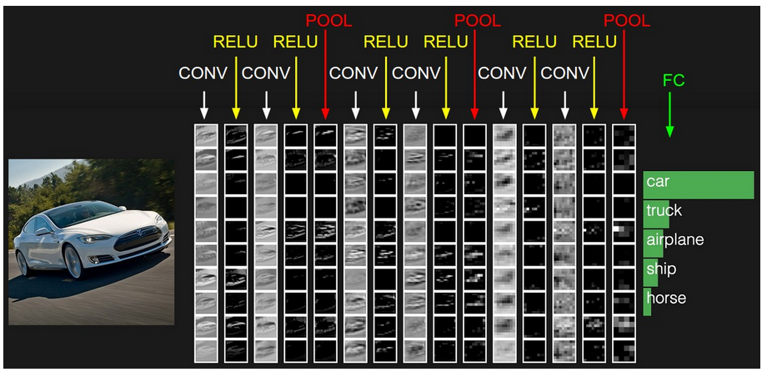
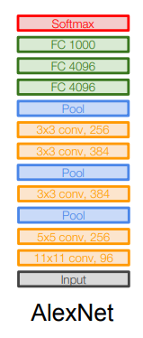
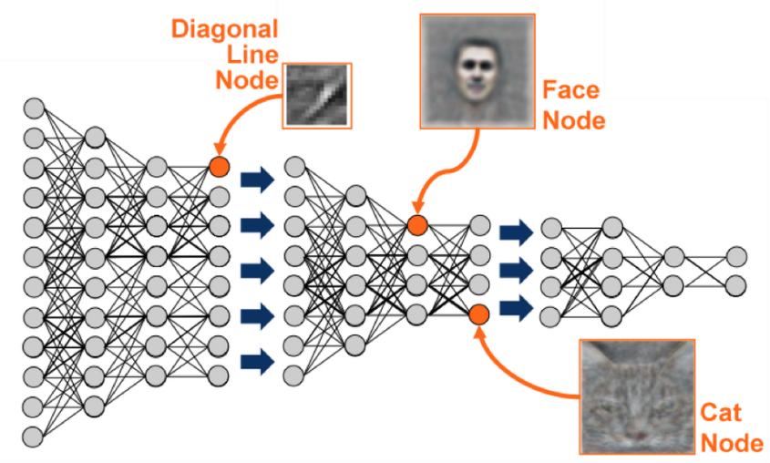
Deep Learning
Carries out the machine learning process using an artificial neural net composed of a number of levels arranged in a hierarchy
Network learns something simple at the initial level in the hierarchy and then sends this information to the next level
Process continues as each level in the hierarchy builds something more complex from the input it received from the previous level
4 main types of layers are used to build ConvNet architectures:
Convolutional Layer
Rectified Linear Activation Layer
Pooling Layer
Fully-Connected Layer (exactly as seen in regular Neural Networks).

Slide 5
Thesis
Implementation of Deep Convolutional Neural Networks is normally done by Computer Scientists using GPUs on Desktop or Laptop Computers.
FPGA implementation of Deep Convolutional Neural Networks would allow for smaller embedded solutions to be designed which would consume less power than GPU solutions.
Allowing an FPGA implementation of Deep CNNs to be programmed by software and use known Deep Learning Architectures would allow for the faster system development .
This work efforts to design and develop a scalable, reusable, and user-friendly FPGA implementation of Convolutional Neural Networks for Image Classification tasks.
Allowing the This design would cater to the smaller more inexpensive Embedded Designs which have strict power and computation constraints.

Slide 6
Implementation Concept
Convolutional Neural Network Layers

Slide 7
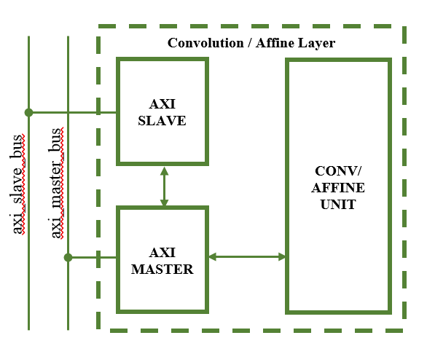
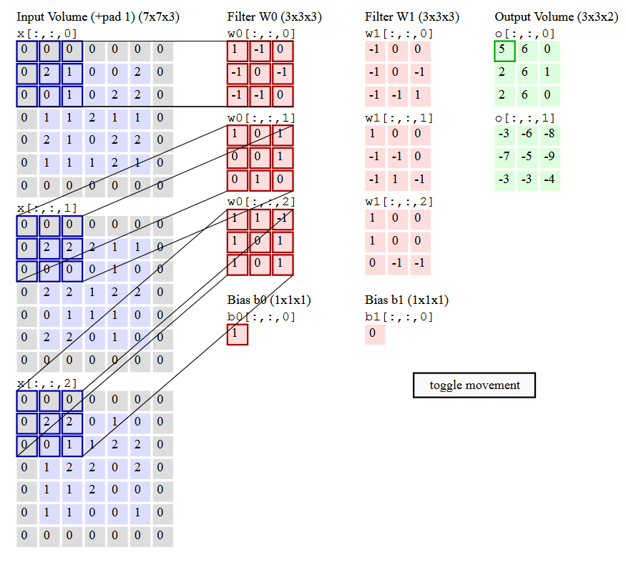
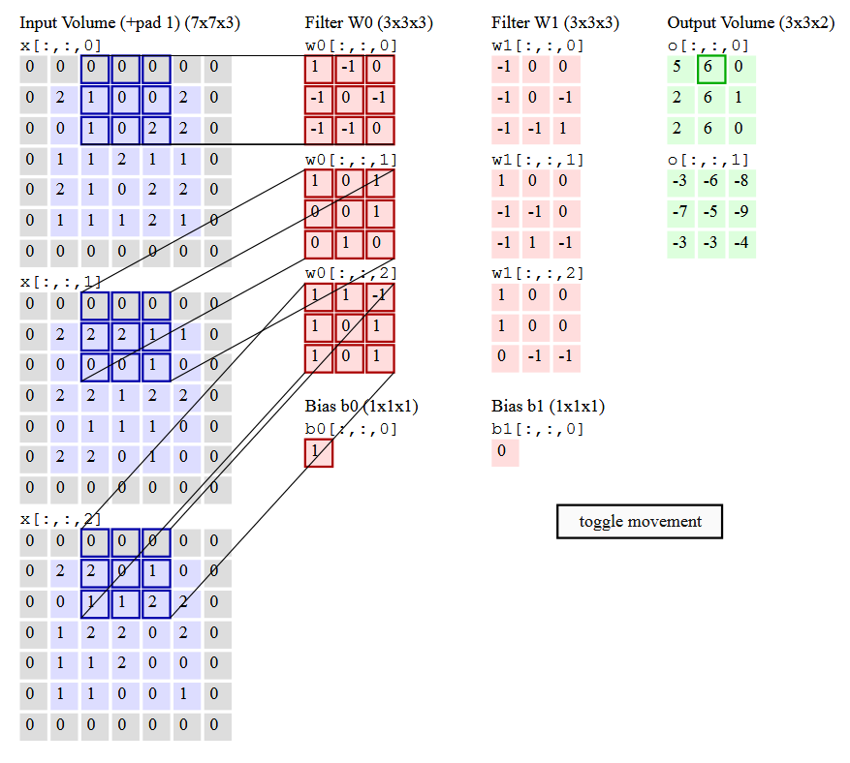
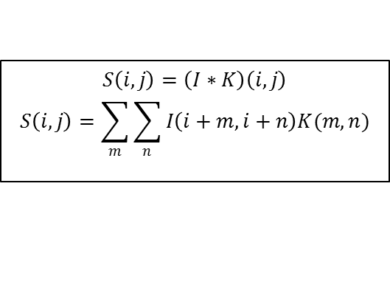
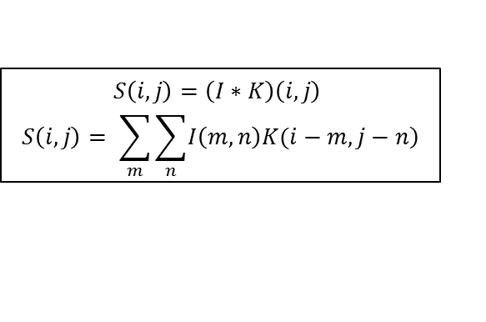
Convolution/Affine Layer
$$S\left(i,j\right)=\left(I∗K\right)\left(i,j\right)$$
$$S\left(i,j\right)= \sum_{m}{\sum_{n}{\left.I\left(m,n\right)K(i−m,j−n\right)}}$$
$$S\left(i,j\right)=\left(I∗K\right)\left(i,j\right)$$
$$S\left(i,j\right)=\sum_{m}{\sum_{n}{I\left(i+m,i+n\right)K(m,n)}}$$
Involves applying a weight filter kernel to an input image to generate an output volume
Kernels filter the image for certain features
Example, 3x3 filter weight kernel
9 filter weight values
9 image data values
generate 9 products.
9 products are then summed
This is done for each channel/color of the input image

Slide 8
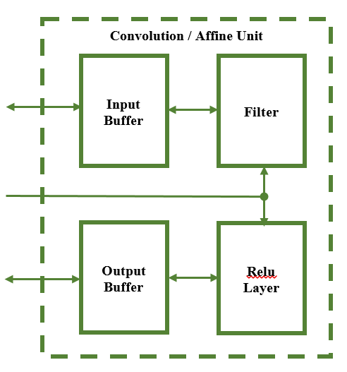
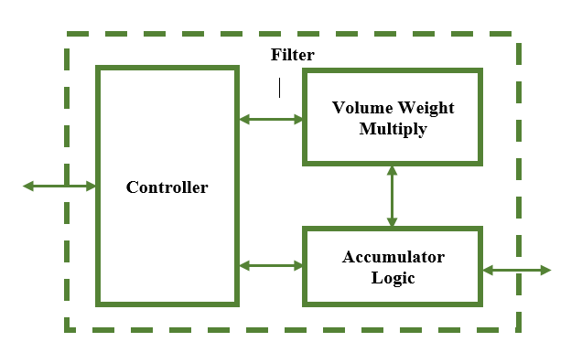
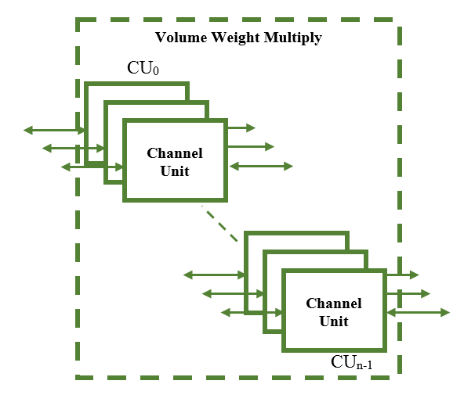
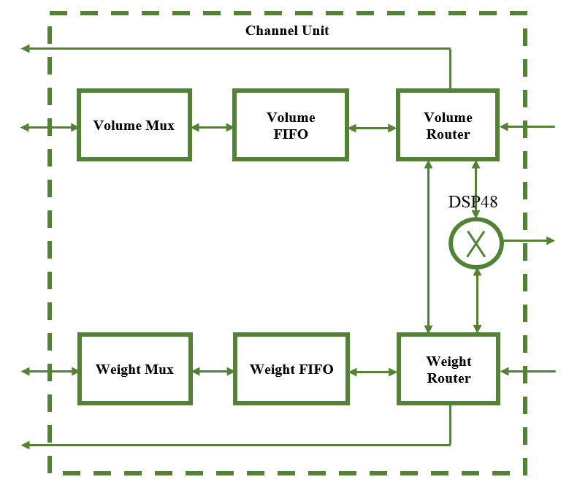
Convolution / Affine Layer
The heart of this design is the Channel Unit which involves FIFO buffers and glue logic
This design utilizes heavily the available DSP resources on the FGPA chip
The number of available DSPs dictates the maximum number of Channel Units instantiated into the design
The height of the weight filter kernel will dictate the number of input volume channels that can be operated on at any given time

Slide 9
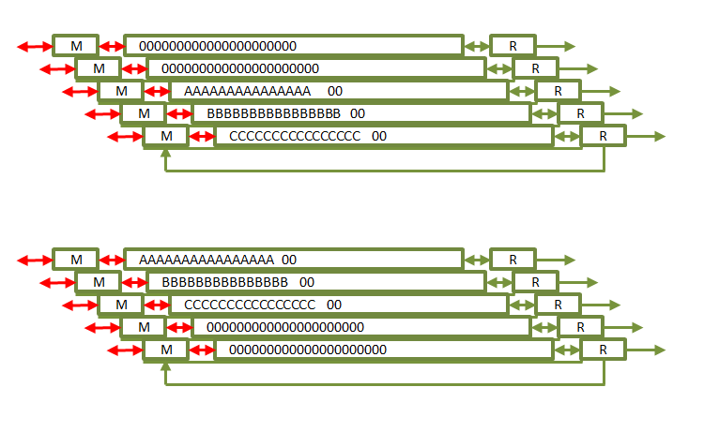
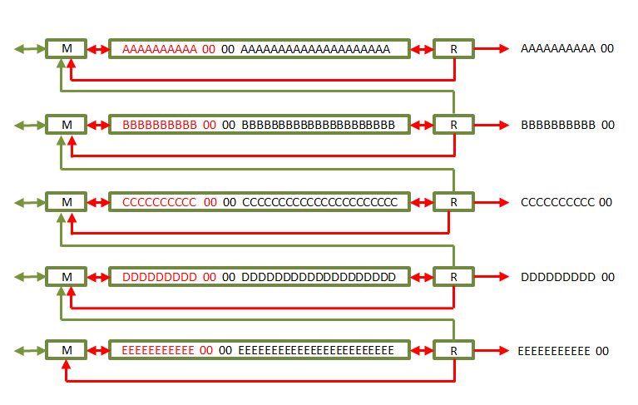
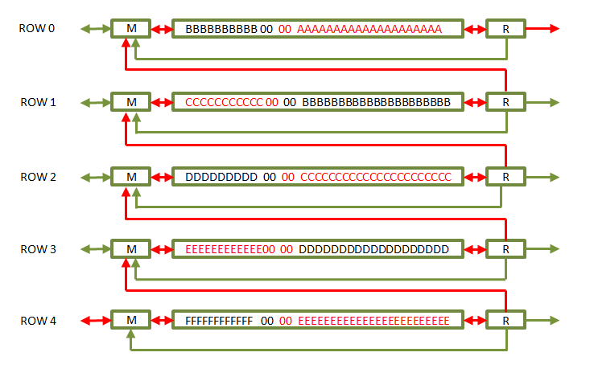
Convolution / Affine Layer
Controller loads full rows input and weight data into the Channel Unit FIFOs
For Convolutional Layers with padding the input data will have top, bottom, right, and left boarders with zero value data
Once loaded, the first Kernel is read out and held in registers in the Weight Router
Row data in the Volume FIFOs are read out according to stride
Input data and Weight data are sent DSP48 multiplier block and written back into the FIFOs
Once current rows are processed, the vertical stride operation for Convolution begins
Routers read out its FIFOs data and send the data to the Mux of the Channel Unit neighboring it
For the Affine operation, the design moves on

Slide 10
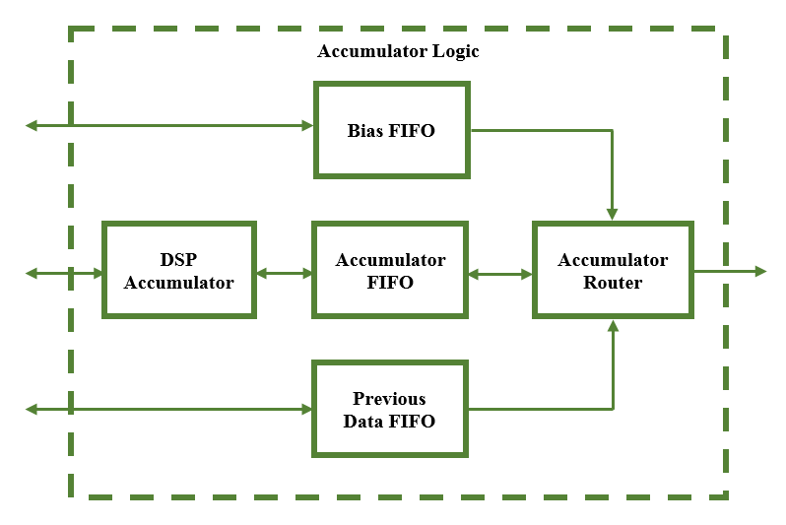
Convolution / Affine Layer
DSP Accumulator uses an adder tree to sum the results of the Convolution or Affine operation together
Results of the adder tree are summed together to arrive at the Kernel Sum.
Kernel sum is written to the Accumulator FIFO
Accumulator Router reads the Accumulator FIFO data and adds it with the Bias data or the Previous data
Process repeats iteratively for each group of channels

Slide 11
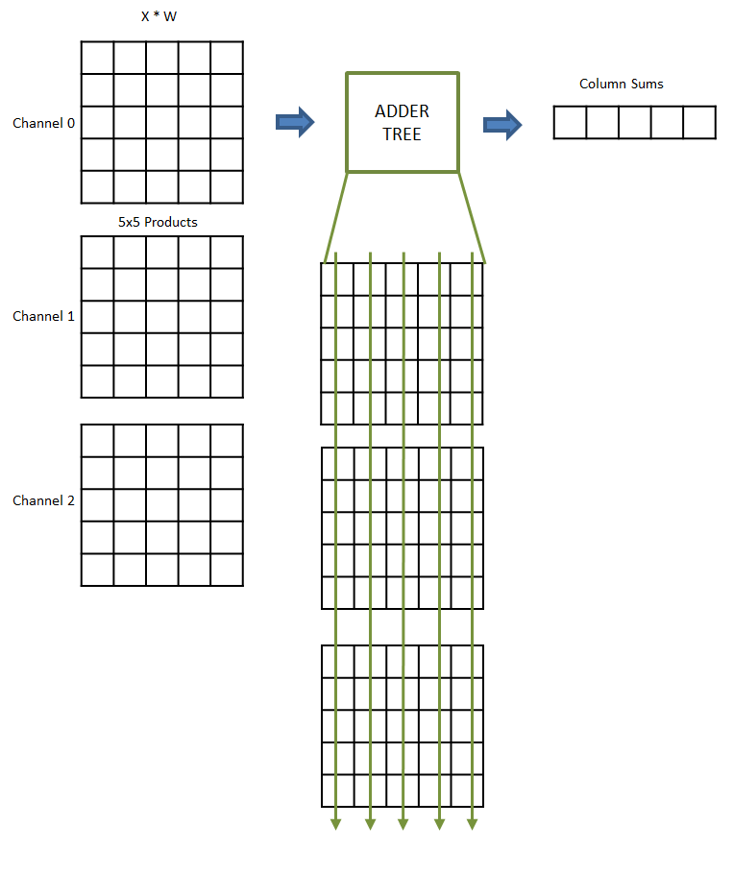
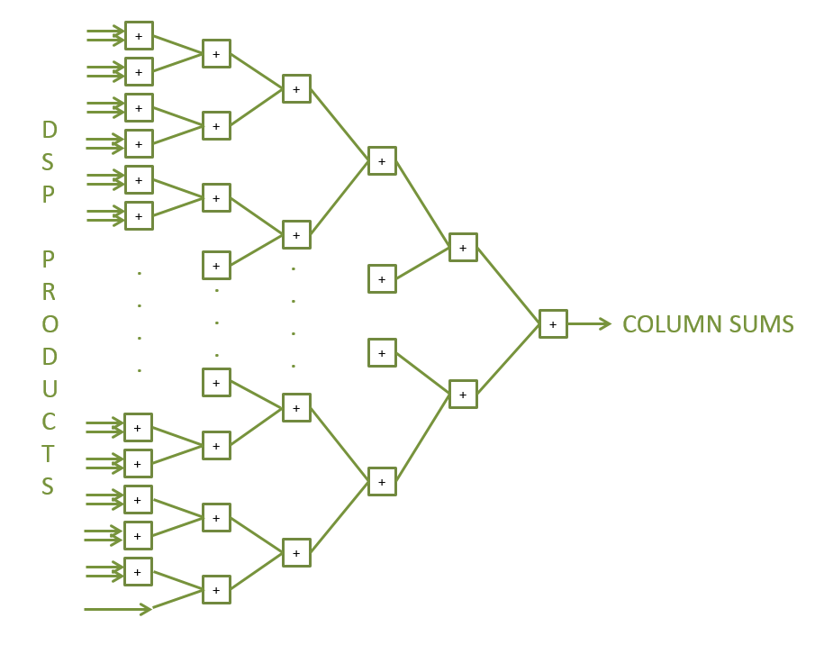
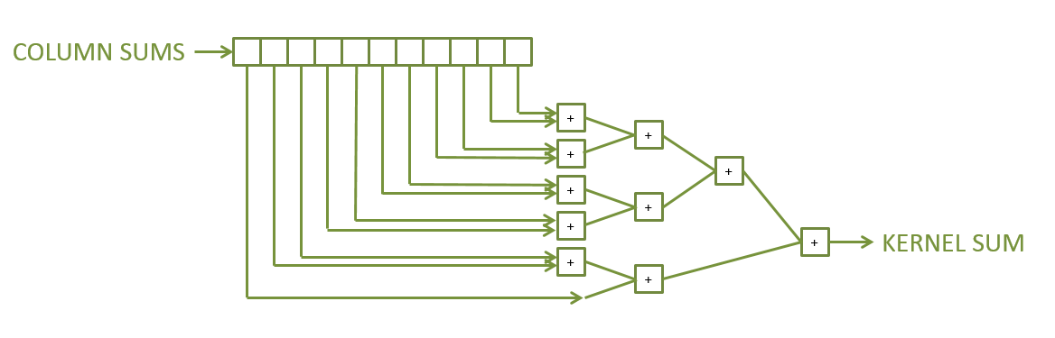
Convolution / Affine Layer
DSP Accumulator uses an adder tree to sum the results of the Convolution or Affine operation together
Adder tree output is the summation of all product data down the columns
Column sums are summed by a smaller adder tree to obtain the single Kernel Sum data value
Process repeats for every element in the output volume data set

Slide 12
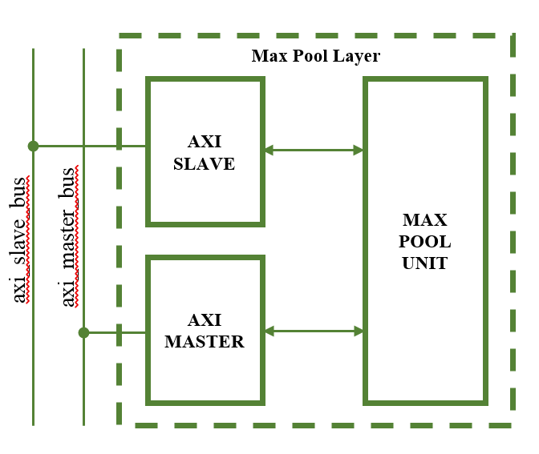
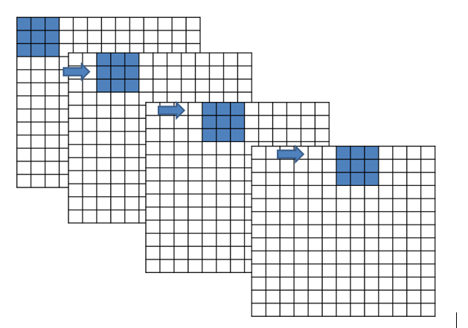
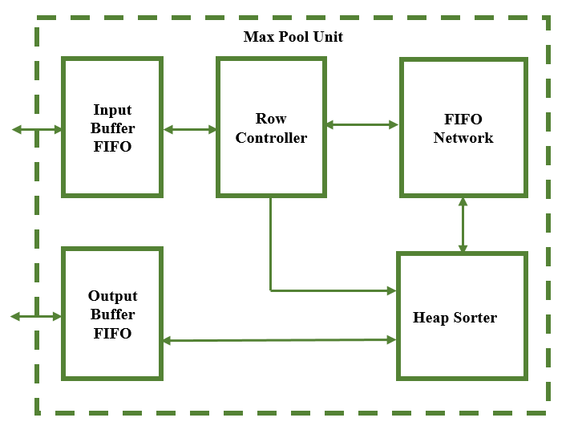
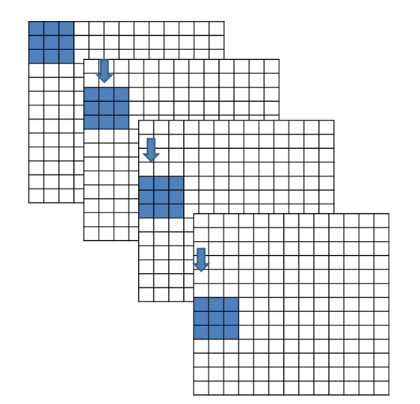
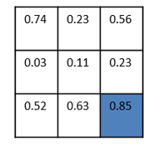
Max Pooling Layer
Involves sliding a 3x3 kernel across 3 rows by 3 columns at a time
Kernel is traversed across the input image by every 2 pixels in both vertical and horizontal directions
At each increment the kernel uses all the values in the 3x3 neighborhood and chooses the greatest value
Max value becomes the output pixel value for the scaled down Max Pooled image
Process is repeated for all channels of the input image

Slide 13
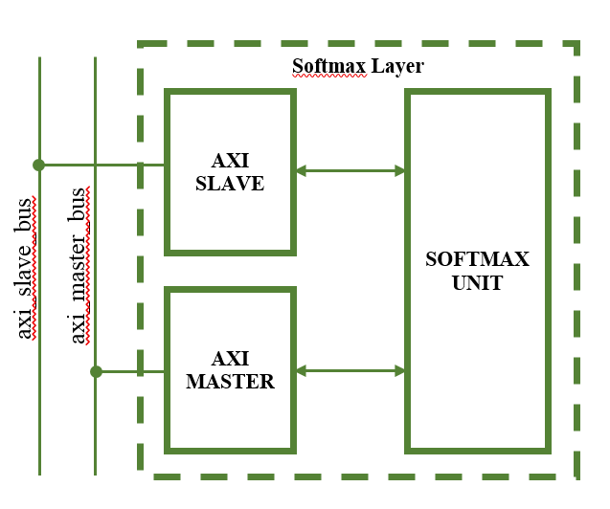
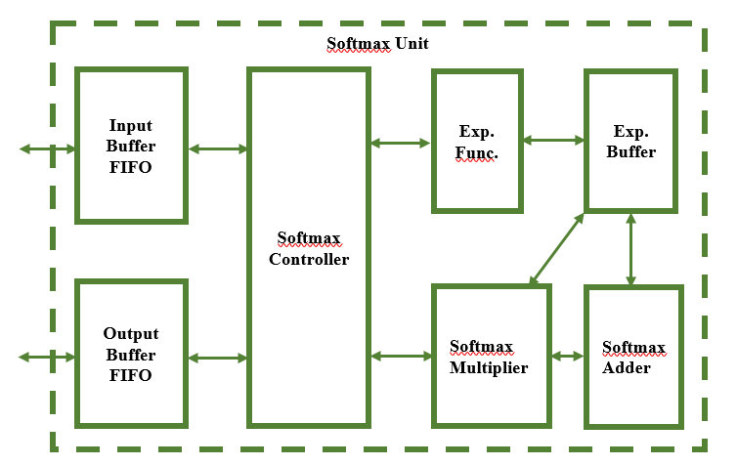
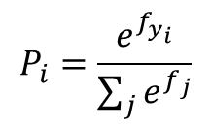
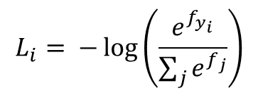
Softmax Layer
To measure how well the neural network has classified the image it was given
Scores are passed through a loss or cost function to get the loss and probability
If Network is doing a good job the loss will be low and probability high
If Network is doing a poor job the loss will be high and probability low
A popular classifier is the Softmax Classifier
Due to mathematical complexity in the FPGA implementation, the Probabilities are output by the Softmax Layer
$$L_{i}= −\log\left(\frac{e^{f_{y_{i}}}}{\sum_{j}{e^{f_{j}}}}\right)$$
$$P_{i}=\frac{e^{f_{y_{i}}}}{\sum_{j}{e^{f_{j}}}}$$

Slide 14

Trained Model
An array of tools in various software environments were made to test and verify the design
Tools from Stanford’s CS231N course were expanded upon to train a CNN model
A small data set of 10 images was used for training with an AlexNet Convolutional Neural Network configuration.
Images were selected from the ImageNet database.
The ImageNet database contains roughly 100,000 individual images spanning 1000 or more classes
Additional Python tools were created to search the database and resize the image to the 227x227 AlexNet input image size.
Class Number | ImageNet ID | Class Description
1 | n04548362 | wallet, billfold, notecase, pocketbook
2 | n03642806 | laptop, laptop computer
3 | n03063599 | coffee mug
4 | n02690373 | airliner
5 | n03930630 | pickup, pickup truck
6 | n01614925 | bald eagle, American eagle, Haliaeetus leucocephalus
7 | n03085013 | computer keyboard, keypad
8 | n02708093 | analog clock
9 | n03272010 | electric guitar
10 | n02992529 | cellular telephone, cellular phone, cellphone, cell, mobile phone

Slide 15
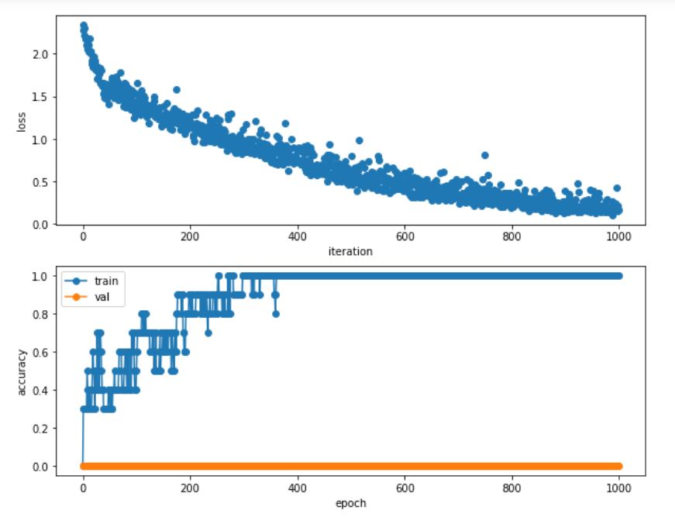
Trained Model
Regularization = 0.0 (No Regularization)
Learning Rate = 5x10⁻³
Weight Scale = 1.5x10⁻²
Iterations = 1000
Batch Size = 10
Update Rule = Stochastic Gradient Descent
Learning Rate Decay = 1.0 (No Decay)

Slide 16
Results
Performance and Output

Slide 17
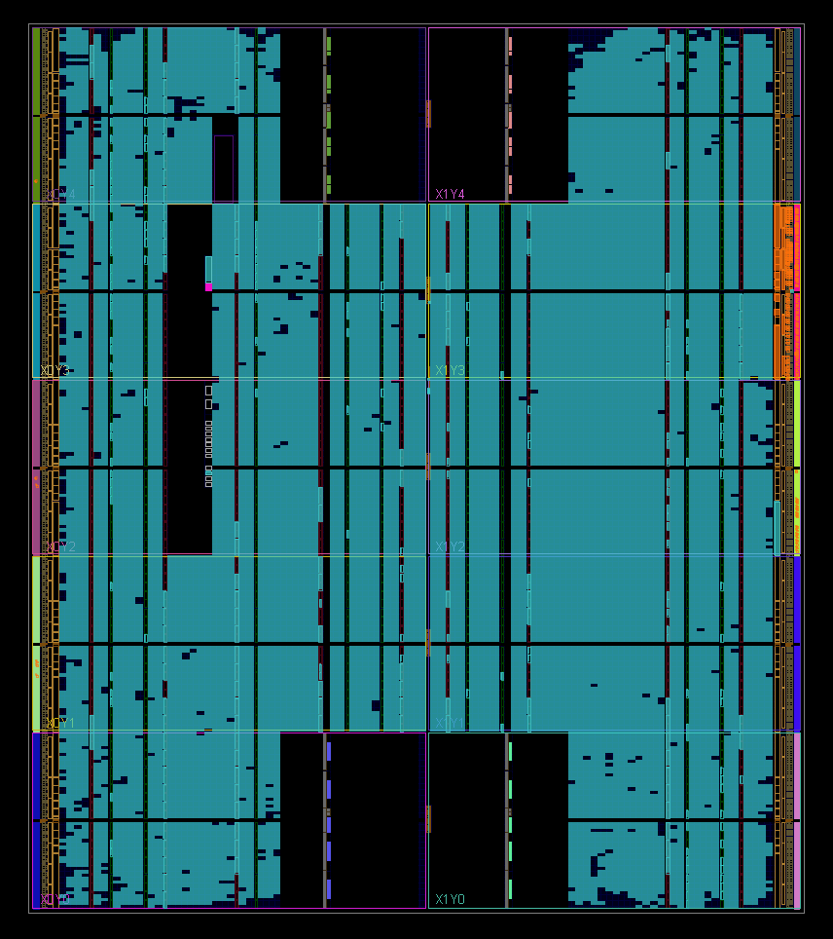
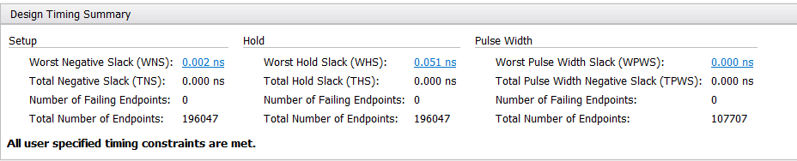
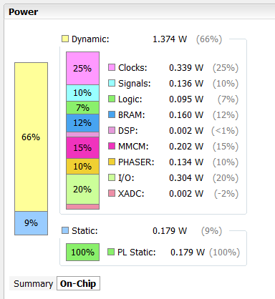
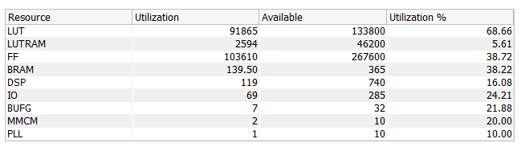
Synthesized & Implemented Design
Implementation met its timing requirements with the constraint of a 100MHz input clock frequency
Design currently is uses ~70% of the FPGA Look-up Tables, ~40% of the FPGA Flip Flops, and ~40% of the FPGA Block RAM
Design currently only uses ~16% of the FPGA DSPs

Slide 18
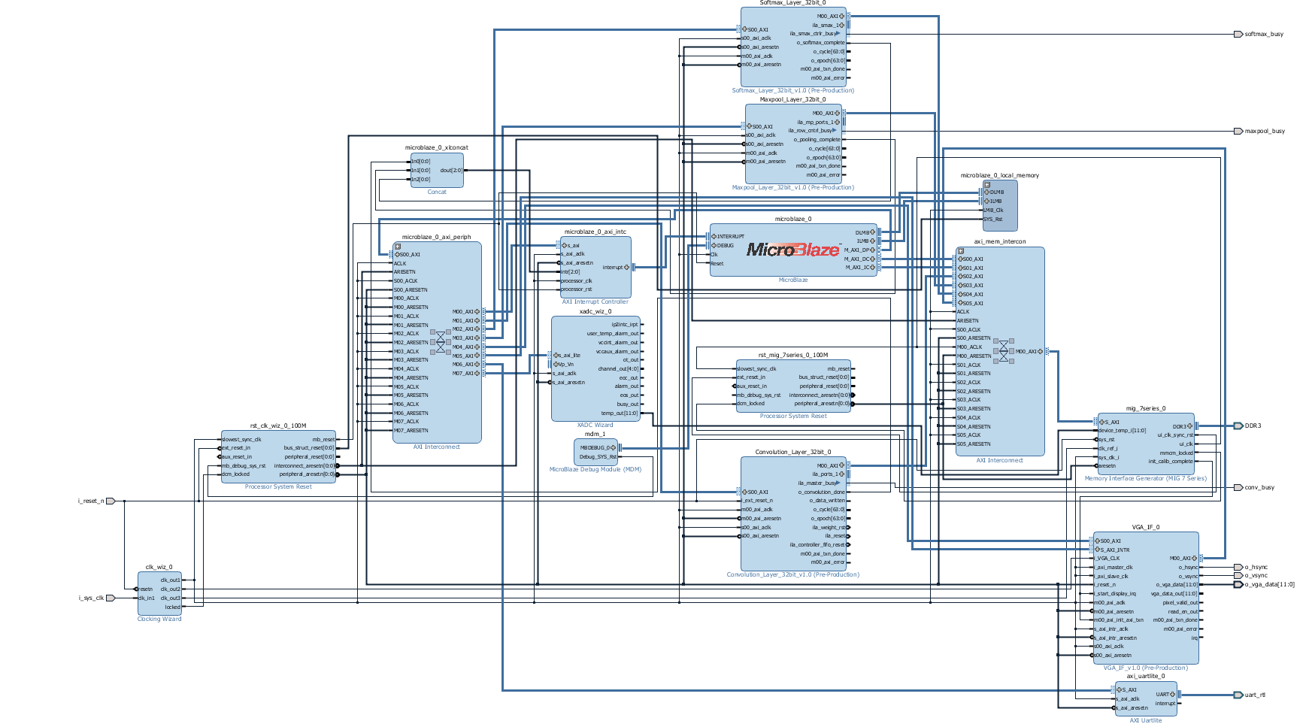

Slide 19
Floating-Point Operations (FLOP)
Each Convolution and Affine layer will perform a certain number of Floating-Point Operations
Number of Floating-Point Operations (FLOPs) divided by the time of execution yields the Floating-Point Operations per Second (FLOPS)
Calculations arriving at the total number of Floating-Point Operations are detailed in the report and are shown below
 | CHU_FLOP | ACC_FLOP | BIAS_FLOP | ROW_FLOP | VOL_FLOP
CONV1 | 1916640 | 1906080 | 96 | 3822720 | 210249696
CONV2 | 1036800 | 1168128 | 256 | 2204928 | 62332672
CONV3 | 359424 | 524160 | 384 | 883584 | 13498752
CONV4 | 359424 | 524160 | 384 | 883584 | 14537088
CONV5 | 239616 | 349440 | 256 | 589056 | 9691392
AFFINE1 | 589824 | 823296 | 4096 | 1413120 | 90701824
AFFINE2 | 131072 | 167936 | 4096 | 299008 | 38797312
AFFINE3 | 320 | 410 | 10 | 730 | 94720

Slide 20
Memory Transactions
The number of memory transactions to perform reads and writes to memory are very important
Each transaction with off chip memory adds delay in the overall execution of the Convolution or Affine Layer
Keeping the number of memory transactions to a minimum will aid the performance of any design
Convolution and Affine Layers reads and writes 4 kinds of data; input image data, weight filter kernel data, bias data, and previous output volume data
Layer | Input Read Trans. | Weight Read Trans. | Bias Read Trans. | Prev Read Trans. | Write Trans. | Total Mem Trans.
CONV1 | 651 | 96 | 1 | 0 | 5280 | 6028
CONV2 | 2592 | 256 | 1 | 103680 | 110592 | 217121
CONV3 | 3328 | 384 | 1 | 154752 | 159744 | 318209
CONV4 | 4992 | 384 | 1 | 234624 | 239616 | 479617
CONV5 | 4992 | 256 | 1 | 156416 | 159744 | 321409
AFFINE1 | 256 | 262144 | 1 | 258048 | 262144 | 782593
AFFINE2 | 4096 | 524288 | 1 | 520192 | 524288 | 1572865
AFFINE3 | 4096 | 1280 | 1 | 1270 | 1280 | 7927

Slide 21
Sim and Hardware Performance
Layer | Start Time | End Time | Total Time | FLOPs
CONV1 | 2.725us | 71733.655 us | 71.73093 ms | 2.931 G
CONV2 | 2.725us | 485199.955 us | 485.19723 ms | 128.468 M
CONV3 | 2.725us | 363293.625 us | 363.2909 ms | 37.156 M
CONV4 | 2.725us | 545573.945 us | 545.57122 ms | 26.645 M
CONV5 | 2.725us | 364695.804598us | 364.693079598ms | 26.574 M
AFFINE1 | 2.725us | 514410.525 us | 514407.8 ms | 176.322 M
AFFINE2 | 2.725us | 442502.215 us | 442499.49 ms | 87.677 M
AFFINE3 | 2.725us | 27927.805 us | 27925.08 ms | 33.919 M
Layer | Start Time | End Time | Total Time | FLOPs
CONV1 | 0 | 71198.67 us Epoch = 0x1161e Cycle = 0x43 | 71.19867 ms | 2.9530 G
CONV2 | 0 | 547753.71 us Epoch = 0x85BA9 Cycle = 0x47 | 547.75371 ms | 108.806 M
CONV3 | 0 | 463776.90 us Epoch = 0x713A0 Cycle = 0x5A | 463.77690 ms | 24.858 M
CONV4 | 0 | 697862.14 us Epoch = 0xaa606 Cycle = 0x0E | 697.86214 ms | 16.551 M
CONV5 | 0 | 466757.25 us Epoch = 0x71f45 Cycle = 0x19 | 466.75725 ms | 16.543 M
AFFINE1 | 0 | 796440.32 us Epoch = 0xc2718 Cycle = 0x20 | 796.44032 ms | 110.922 M
AFFINE2 | 0 | 1018890.52 us Epoch = 0xf8c0a Cycle = 0x34 | 1018.89052 ms | 33.446 M
AFFINE3 | 0 | 4682.26 us Epoch = 0x124A Cycle = 0x1A | 4.68226 ms | 17.769 M

Slide 22
Output Results
The 10 randomly selected images from the 10 class list were run through the hardware FPGA implementation running AlexNet
All 10 images were classified correctly by the FPGA hardware with the image’s class being correctly identified
Image # | Image ID | Model Class | Model Score | HW Class | HW Score Hex | HW Score Dec | %Diff
1 | n02690373_3435 | 4 | 7.771 | 4 | 0x40F8778B | 7.7646 | 0.0824
2 | n02708093_1783 | 8 | 5.008 | 8 | 0x40A05553 | 5.0104 | 0.0479
3 | n02992529_59933 | 10 | 4.844 | 10 | 0x409AF820 | 4.8428 | 0.0248
4 | n02690373_6755 | 4 | 9.227 | 4 | 0x41138E41 | 9.2222 | 0.0520
5 | n03930630_24834 | 5 | 6.361 | 5 | 0x40CB98F0 | 6.3624 | 0.0220
6 | n02708093_3688 | 8 | 5.808 | 8 | 0x40BA17C8 | 5.8154 | 0.1272
7 | n02690373_17389 | 4 | 9.753 | 4 | 0x411C0F50 | 9.7537 | 0.0072
8 | n03063599_3650 | 3 | 8.181 | 3 | 0x41028B29 | 8.159 | 0.2696
9 | n03063599_4149 | 3 | 5.665 | 3 | 0x40B4E50D | 5.653 | 0.2123
10 | n03063599_5006 | 3 | 7.136 | 3 | 0x40E41692 | 7.1278 | 0.1150

Slide 23
Output Results
The 10 randomly selected images from the 10 class list were run through the hardware FPGA implementation running AlexNet
All 10 images were classified correctly by the FPGA hardware with the image’s class being correctly identified
Image # | Image ID | HW Class | HW Score Hex | HW Score Dec | HW Probs Hex | HW Probs %
1 | n02690373_3435 | 4 | 0x40F8778B | 7.7646 | 0x3F7D7487 | 99.01
2 | n02708093_1783 | 8 | 0x40A05553 | 5.0104 | 0x3F53D255 | 82.74
3 | n02992529_59933 | 10 | 0x409AF820 | 4.8428 | 0x3F55CC70 | 83.52
4 | n02690373_6755 | 4 | 0x41138E41 | 9.2222 | 0x3F7C6A0D | 98.60
5 | n03930630_24834 | 5 | 0x40CB98F0 | 6.3624 | 0x3F576CE9 | 84.15
6 | n02708093_3688 | 8 | 0x40BA17C8 | 5.8154 | 0x3F6FC1F4 | 93.66
7 | n02690373_17389 | 4 | 0x411C0F50 | 9.7537 | 0x3F7ECA8E | 99.53
8 | n03063599_3650 | 3 | 0x41028B29 | 8.159 | 0x3F674FB1 | 90.36
9 | n03063599_4149 | 3 | 0x40B4E50D | 5.653 | 0x3F6A050F | 91.41
10 | n03063599_5006 | 3 | 0x40E41692 | 7.1278 | 0x3F7A8D36 | 97.87

Slide 24
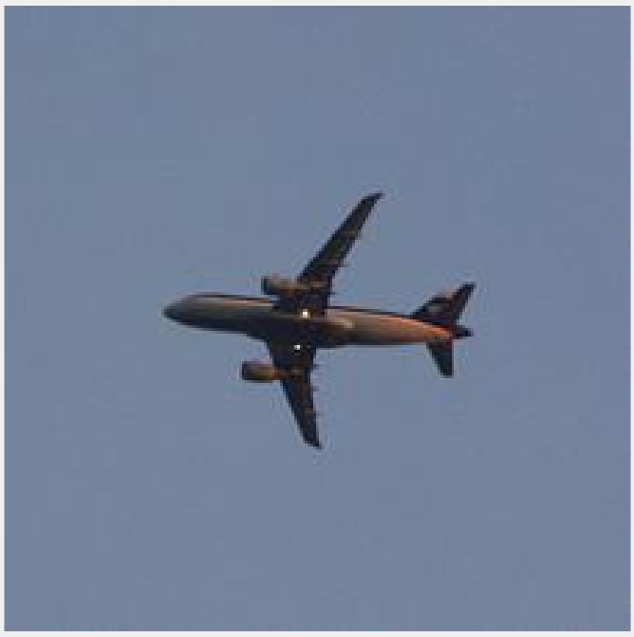
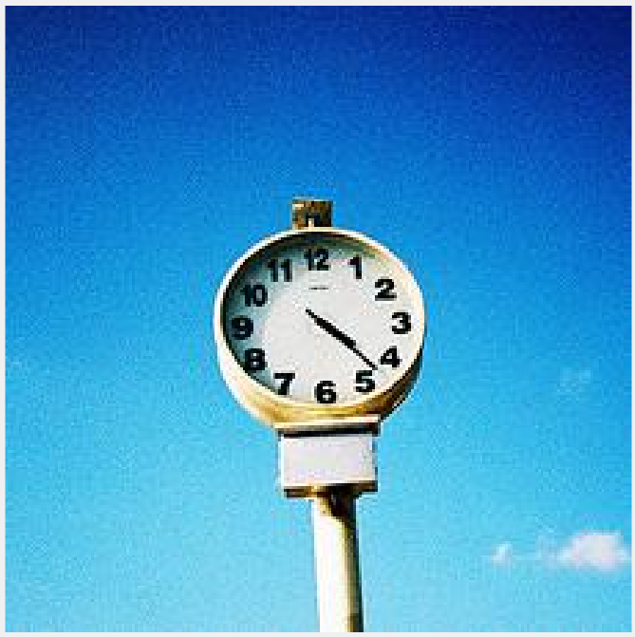
Output Results
n02690373_6755
n02708093_3688

Slide 25
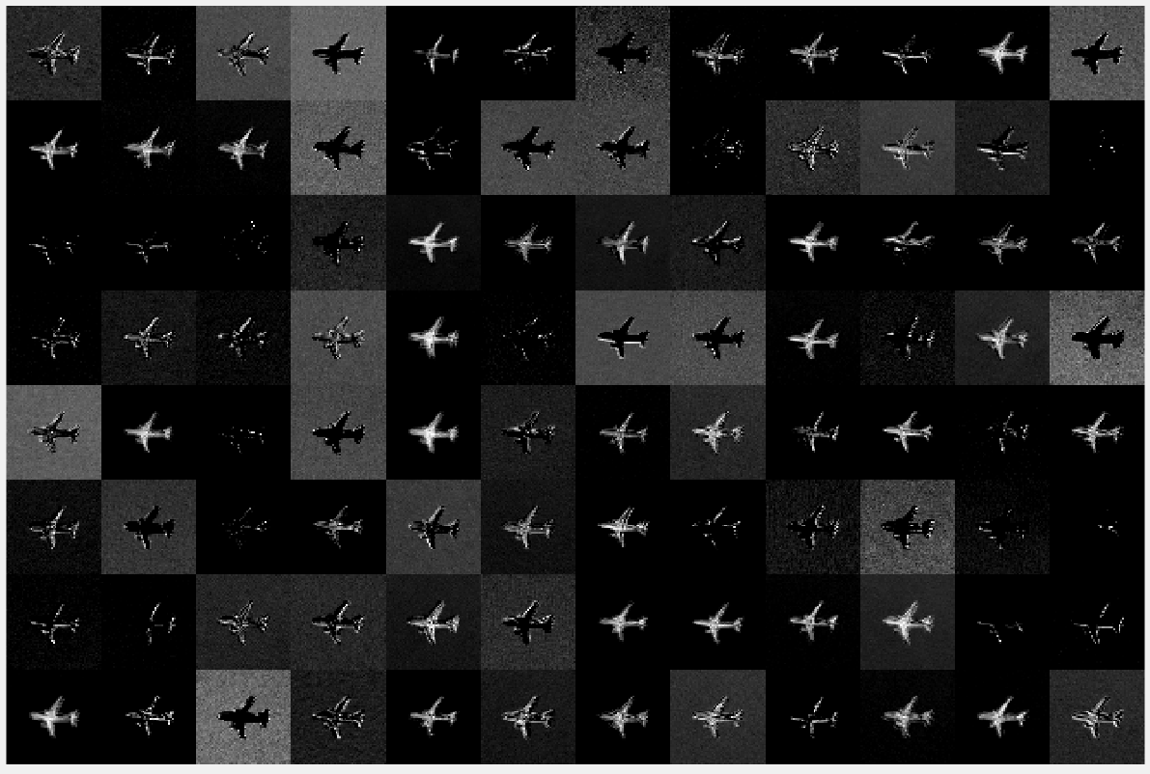
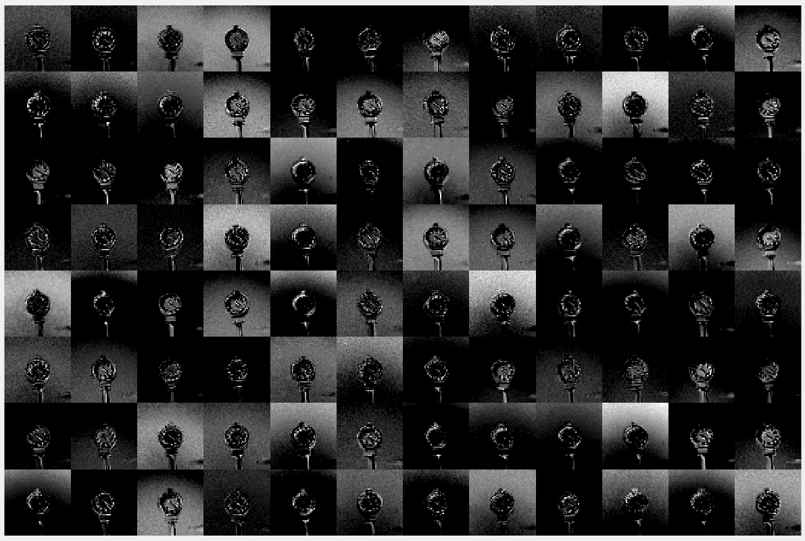
Output Results
CONV1 Output
55x55x96

Slide 26
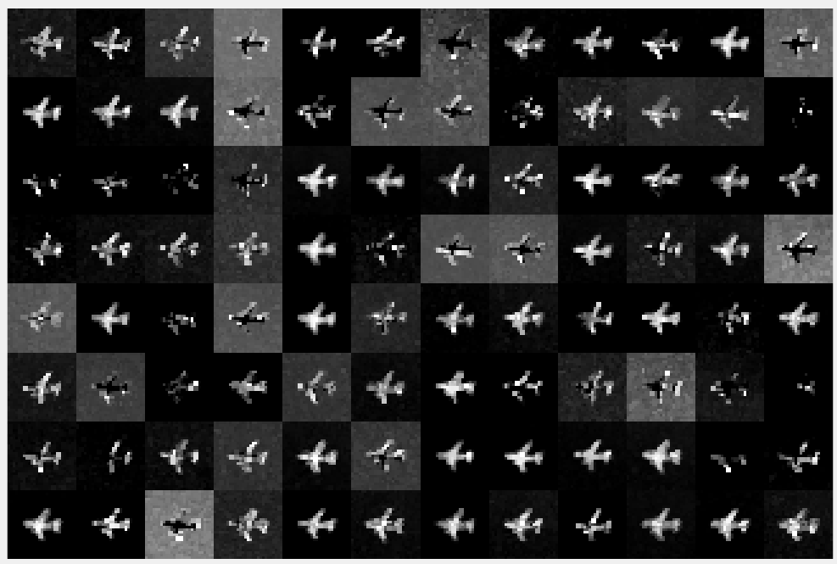
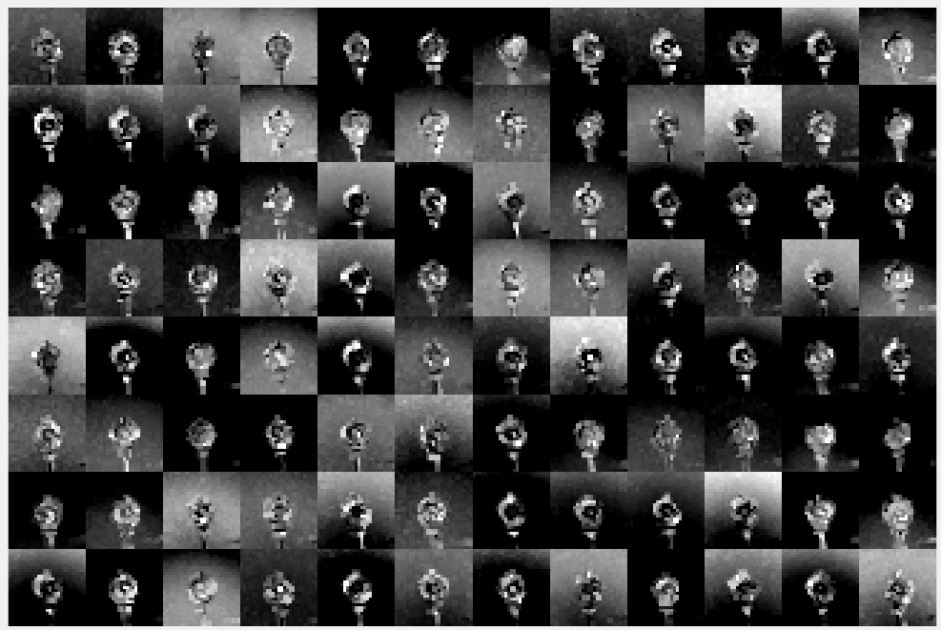
Output Results
MAXPOOL1 Output
27x27x96

Slide 27
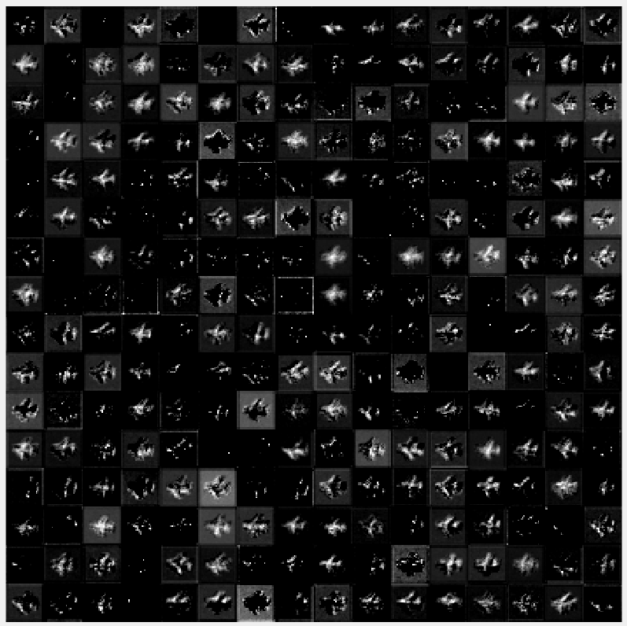
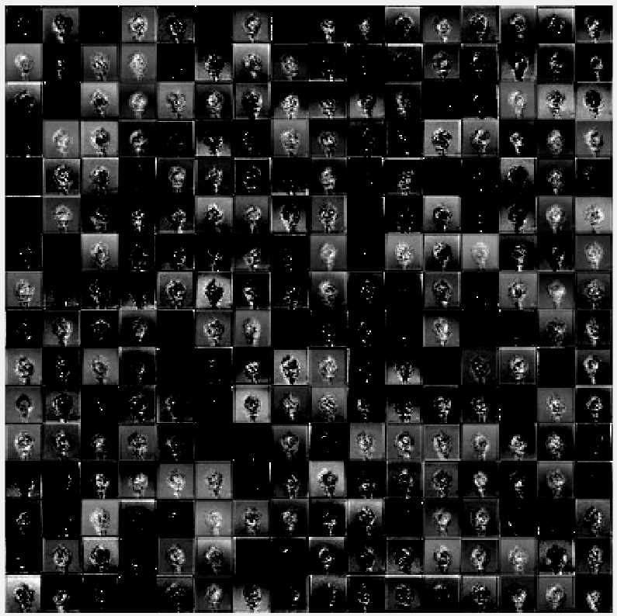
Output Results
CONV2 Output
27x27x256

Slide 28
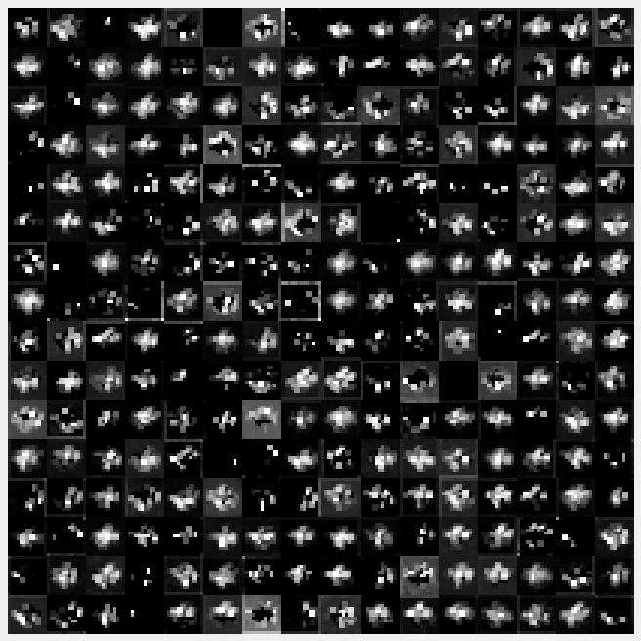
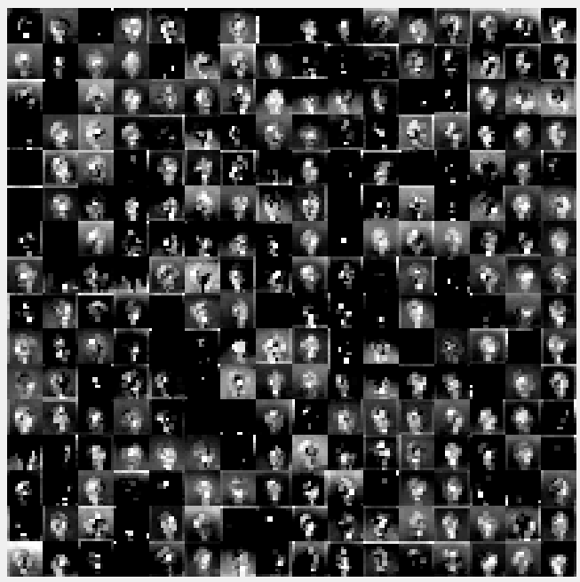
Output Results
MAXPOOL2 Output
13x13x256

Slide 29
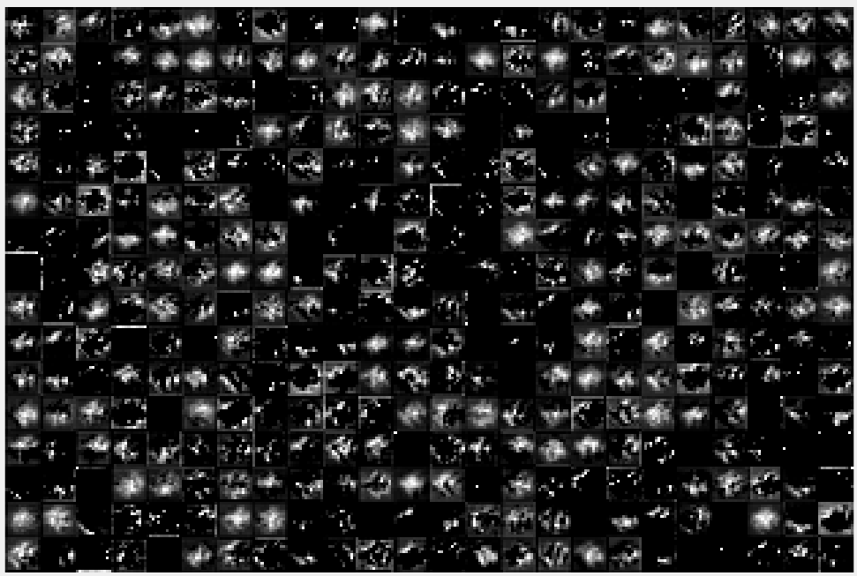
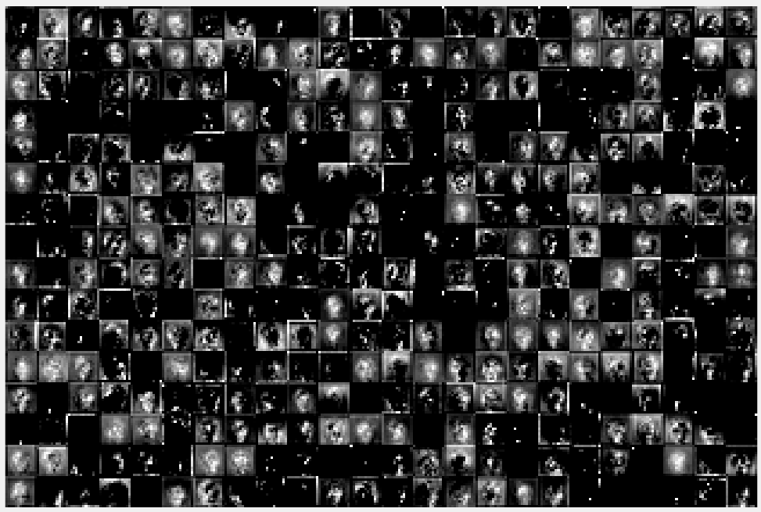
Output Results
CONV3 Output
13x13x384

Slide 30
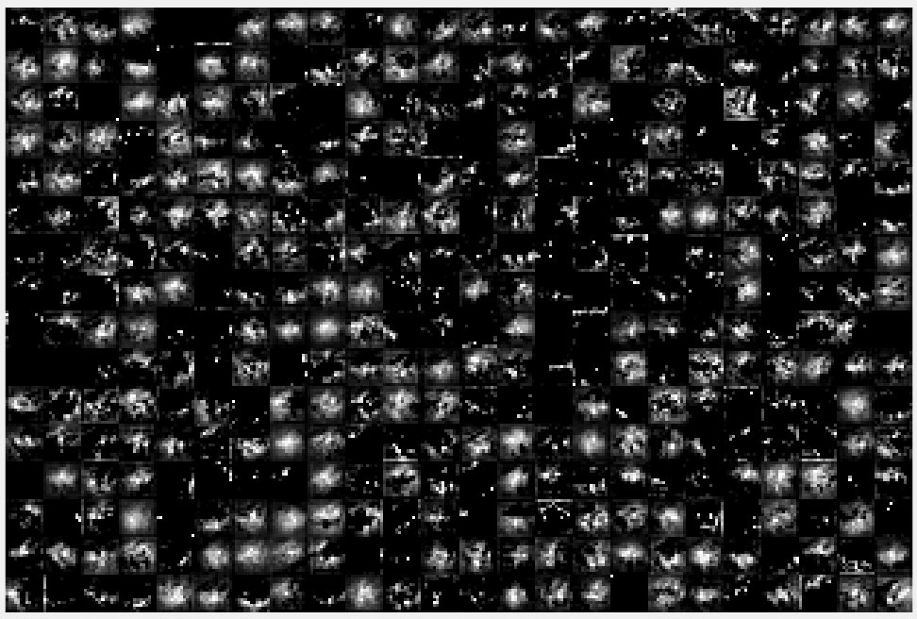

Output Results
CONV4 Output
13x13x384

Slide 31


Output Results
CONV5 Output
13x13x256

Slide 32


Output Results
MAXPOOL3 Output
6x6x256

Slide 33


Performance Breakdown
There exists a relationship between the FLOP to be performed and the Memory Transactions needed versus the FLOPS performance
The balance between the operations needed and the memory transactions needed dictated the achievable performance.
These results are consistent with the Roofline Model developed by UC Berkeley
Layer | Ops To Perform | SIM FLOPS | HW FLOPS | Total Mem Trans. | Ratio
CONV1 | 210249696 | 2.931 G | 2.9530 G | 6028 | 34878.85
CONV2 | 62332672 | 128.468 M | 113.796 M | 217121 | 287.09
CONV3 | 13498752 | 37.156 M | 29.106 M | 318209 | 42.42
CONV4 | 14537088 | 26.645 M | 20.830 M | 479617 | 30.31
CONV5 | 9691392 | 26.574 M | 20.763 M | 321409 | 30.15
AFFINE1 | 90701824 | 176.322 M | 113.884 M | 782593 | 115.90
AFFINE2 | 38797312 | 87.677 M | 38.077 M | 1572865 | 24.67
AFFINE3 | 94720 | 33.919 M | 20.229 M | 7927 | 11.95
$$Attainable Perf. =min\left\{\begin{aligned}&Computational Roof \\ &CTC Ratio ×BW\end{aligned}\right.$$

Slide 34
Hardware Breakdown

Slide 35
Simulation Breakdown

Slide 36
Performance Comparison
 | Guo, K. et. al., 2016 | Ma, Y et. al., 2016 | Zhang, C. et. al., 2015 | Qiao, Y. et. al., 2016 | This Work
FPGA | Zynq XC7Z045 | Stratix-V GXA7 FPGA | Virtex7 VX485T | Zynq XC7Z045 x 2 | Artix7 XC7A200T
Clock Freq | 150 MHz | 100MHz | 100MHz | 150MHz | 100MHz
Data format | 16-bit fixed | Fixed(8-16b) | 32-bit Float | 32-bit Float | 32-bit Float
Power | 9.63 W (measured) | 19.5 W (measured) | 18.61 W (measured) | 14.4 W (measured) | 1.5 W (estimated)
FF | 127653 | ? | 205704 | 218296 | 103610
LUT | 182616 | 121000 | 186251 | 183190 | 91865
BRAM | 486 | 1552 | 1024 | 402 | 139.50
DSP | 780 | 256 | 2240 | 836 | 119
Performance | 187.80 GFLOPS | 114.5 GFLOPS | 61.62 GFLOPS | 77.8 GFLOPS | 2.93 GFLOPS

Slide 37
Methods of Improvement
This implementation of a Convolutional Neural Network in an AlexNet configuration is a first attempt
Increase DSP Usage
The current design depends heavily on the Channel Unit structure
Increasing the number of DSPs would increase channels processed at a time
More channels mean memory transactions needed decreases
Performance capability of each layer would increase
Increase Clock Frequency
Increase the clock frequency output by the Phase Locked Loop generating the FPGA system clock
Current design uses a 100MHz system clock frequency
Doubling the clock frequency could possibly increase the max system performance to 6 GFLOPs
16bit Data Format
16 bit fixed point employed by some other works
To reduce the number of bits used to represent data values throughout the FPGA
Another data format to possibly use is the 16-bit Half Precision format
Reduces latency for mathematical operations
Design Optimization
Optimize the already existing logic to speed up operations.
This implementation is a first attempt and logic optimization for speed was sacrificed for functionality

Slide 38
Conclusions

Slide 39
Conclusions
Machine Learning and Deep Learning are gaining popularity and these algorithms have been successfully deployed in applications such as Natural Language Processing, Optical Character Recognition, and Speech Recognition
Convolutional Neural Network research has been typically performed by Computer Scientists using GPUs
GPUs while effective at processing large amounts of image data, are extremely power hungry
This work set out to develop a scalable and modular FPGA implementation for Convolutional Neural Networks which could:
Be configured to run many layers
Run currently defined CNN configurations, like AlexNet
Be programmable by software
This type of system would allow a developer to scale a design to fit any size of FPGA from the most inexpensive to the costliest cutting-edge chip on the market
The thesis of this work was proven to be correct that a system such as this can be developed for a small Embedded System and be easily programmed by software

